Slide 1
Internet of Things with Intel A3 – Programming Methods
paul.guermonprez@intel.com

Slide 2
Options
1. Arduino IDE for Intel IoT Platforms
2. Intel XDK for IoT
3. Intel IoT SDK with eclipse
4. Linux development on the board
5. Conclusion

Slide 3
1. Arduino IDE for Intel IoT Platforms
Emulating Arduino on Intel

Slide 4
Arduino IDE for Intel IoT platforms
Installation :
On your PC : The Arduino IDE is easy to install and start. Note : You’ll need the Intel version of the Arduino IDE.
Boards : Arduino emulator is already on Galileo and Edison, just update the firmware. Easy.
Arduino IDE is designed for very simple projects only, but won’t go very far. Excellent docs and community.
https://software.intel.com/en-us/iot/downloads

Slide 5
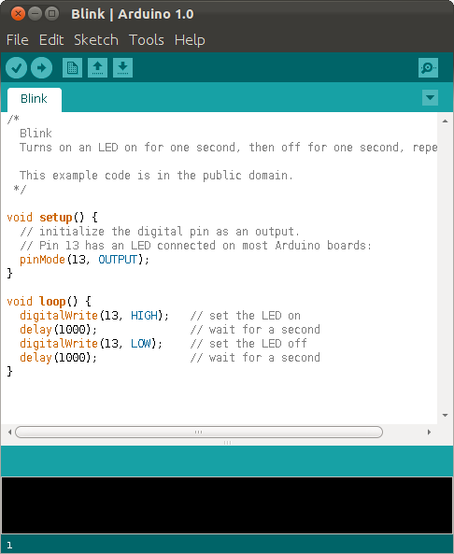
Arduino IDE for Intel IoT platforms

Slide 6
Problem #1 : Potential
The original Arduino is based on a microcontroller. There’s an software emulator simulating this microcontroller on Galileo and Edison.
But Intel IoT platforms are processor based.
That’s why, with this method, you’re only using a minuscule fraction of the processing and networking potential of the platform.
You can make IoT with this method, but basic IoT, not smart IoT.

Slide 7
Problem #2 : Compatibility
This software emulator can’t fully emulate the microcontroller, specifically the real time aspects.
First because the OS is not real time itself, but also because the granularity would not be the same.
Result : some core Arduino IDE libraries are not available, some sensors like depth sensor or some LED strips won’t work.

Slide 8
Conclusion
Public for the Arduino IDE :
Electronicians with very limited software skills appreciate the Arduino IDE
Makers with Arduino experience !
With an minimal interest in software and Linux
With no interest in moving to production later

Slide 9
2. Intel XDK IoT Edition
Sandbox development for web developers

Slide 10
Intel XDK IoT Edition
Familiar for web developers familiar with JavaScript. But if you like NodeJS on linux, check the option 4 : linux.
Limited functionalities and libraries but validated kits of Plug’n’Play sensors.
Easy to install and start the IDE, but flashing the board is not yet easy. You’ll need to find and flash a microSD card.
https://software.intel.com/en-us/iot/downloads

Slide 11
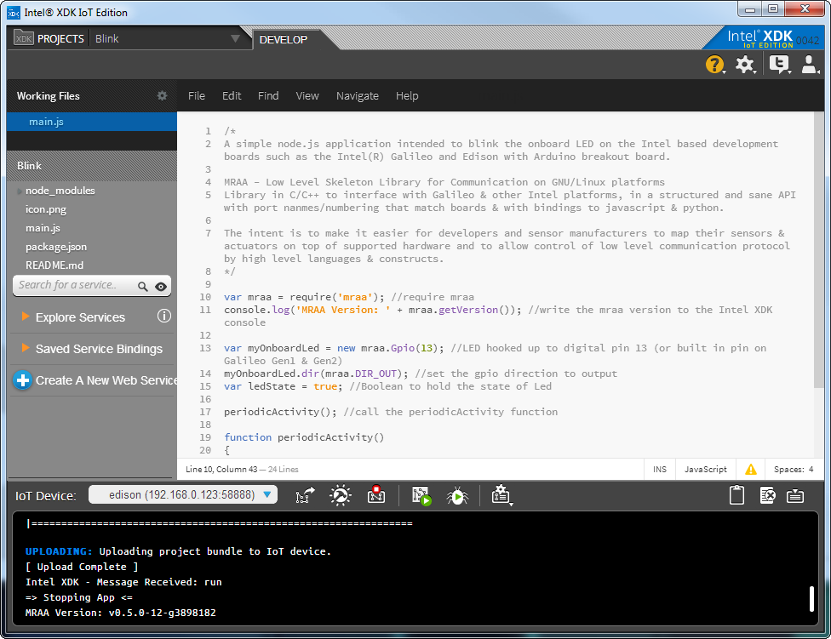
Intel XDK IoT Edition

Slide 12
Intel XDK IoT Edition
Public :
Good for web devs or beginners in software development
If your project plans to stay within the set of validated PnP sensors
Not interested in using linux at all
Compared to Arduino, you can add a lot more code with the Intel XDK. You can evolve into linux-NodeJS development if you want to go further.

Slide 13
3. Intel IoT Developer Kit
With Eclipse IDE development

Slide 14
Intel IoT SDK
Eclipse on your workstation, communicating with the IoT board.
You don’t really access the board itself or the linux OS running on it.
Mainly C development.

Slide 15
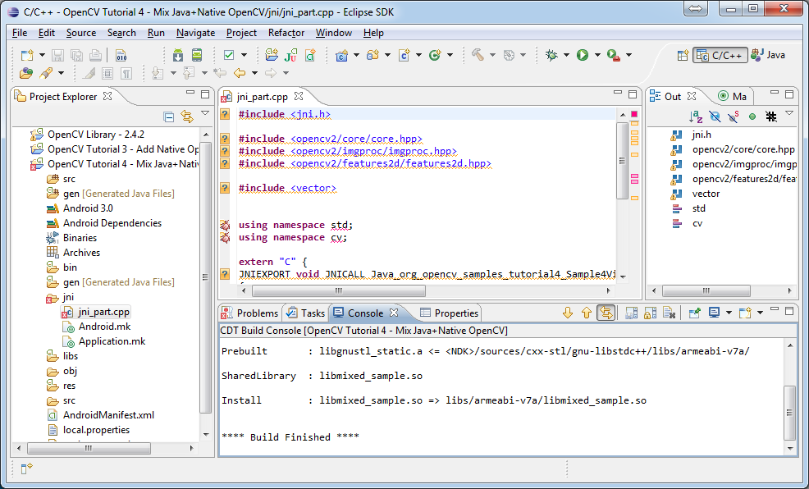
Intel IoT SDK

Slide 16
Intel IoT SDK
Public :
Fan of C development with Eclipse
Don’t need linux access or to add linux packages for your project
Not interested in using linux at all
Want to code high performance C code
Compared to the XDK, C is less fun than JavaScript.
You can evolve into linux-C development if you want to go further.

Slide 17
Linux development on the board
Low level, no limits, linux style

Slide 18
Linux development on the board
You ssh to the board from network or usb, install all the packages you need, and code with any language on linux.
Nothing to install on your PC : Great for workshop setups.
Edit with nano, emacs or vi.
Compile with gcc on the board.
Or use VMs like Python, NodeJS, …
Play with linux services like bluez for advanced Bluetooth features.
Interact with the Yocto professional embedded distribution, or even rebuilt your distro from scratch.
Highly recommended on linux for IoT : NodeJS with Cylon.

Slide 19
Linux development on the board
Public :
good for linux, perfect if you like Raspberry Pi
connect any sensor on earth
you control everything at low level, required if you want to move to production later
you don’t want or have no install to install something on your PC

Slide 20
Conclusion

Slide 21
Conclusion
Good news : there’s a method for everyone.
Evolution paths :
Arduino : no easy evolution
XDK : you can evolve towards linux or SDK
SDK : you can evolve towards linux
Linux : you can evolve towards production and professional IoT embedded development

Slide 22
Conclusion
Because this course is designed for universities, specifically software students, we’ll use the Linux method, with a strong focus on NodeJS/Cylon for rapid prototyping.
It is the best method to understand how things work inside and learn.

Slide 23
License Creative Commons – By 3.0
You are free:
to Share — to copy, distribute and transmit the work
to Remix — to adapt the work
to make commercial use of the work
Under the following conditions:
Attribution — You must attribute the work in the manner specified by the author or licensor (but not in any way that suggests that they endorse you or your use of the work).
With the understanding that:
Waiver — Any of the above conditions can be waived if you get permission from the copyright holder.
Public Domain — Where the work or any of its elements is in the public domain under applicable law, that status is in no way affected by the license.
Other Rights — In no way are any of the following rights affected by the license:
Your fair dealing or fair use rights, or other applicable copyright exceptions and limitations;
The author's moral rights;
Rights other persons may have either in the work itself or in how the work is used, such as publicity or privacy rights.
Notice — For any reuse or distribution, you must make clear to others the license terms of this work. The best way to do this is with a link to this web page.
http://creativecommons.org/licenses/by/3.0/

